Slide 1
Toward a World of World-Historical Data
Ruth Mostern
University of California, Merced
World Historical Dataverse Colloquium
University of Pittsburgh, March 27, 2012

Slide 2
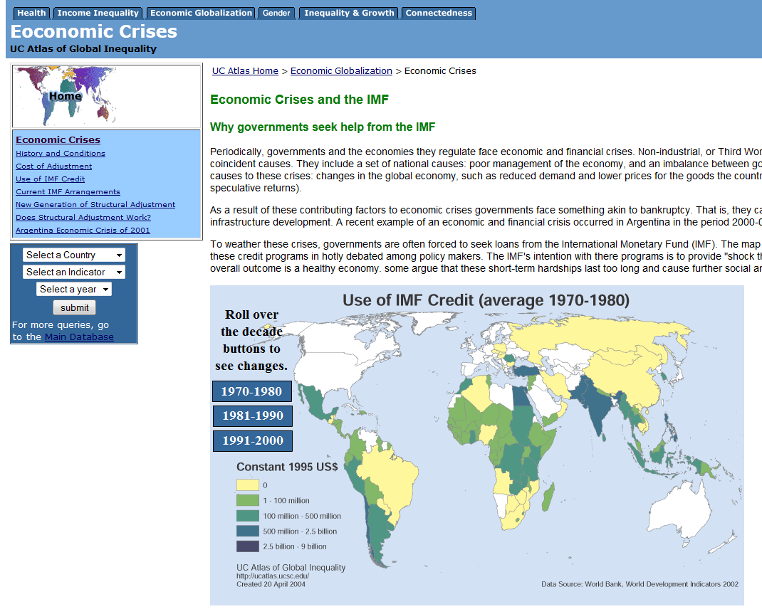
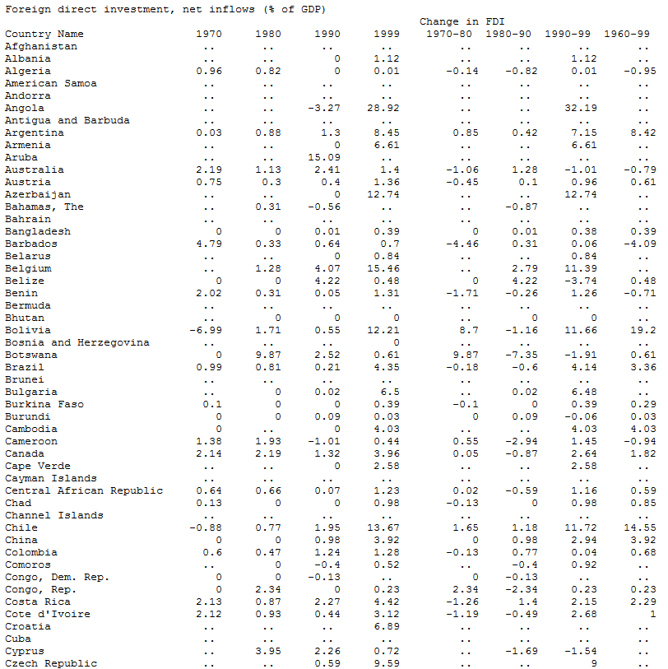
The UC Atlas of Global Inequality
http://ucatlas.ucsc.edu/

Slide 3
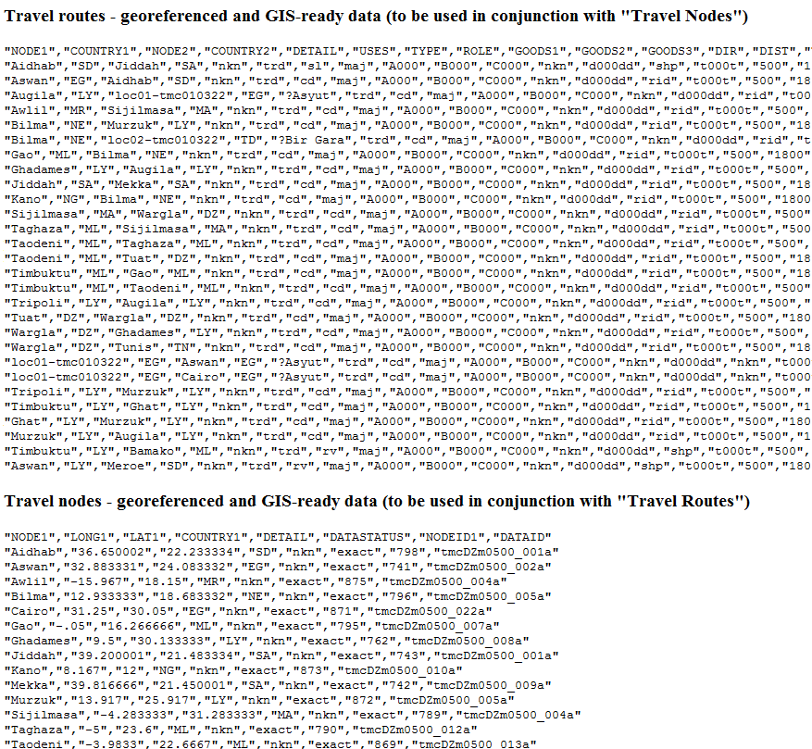
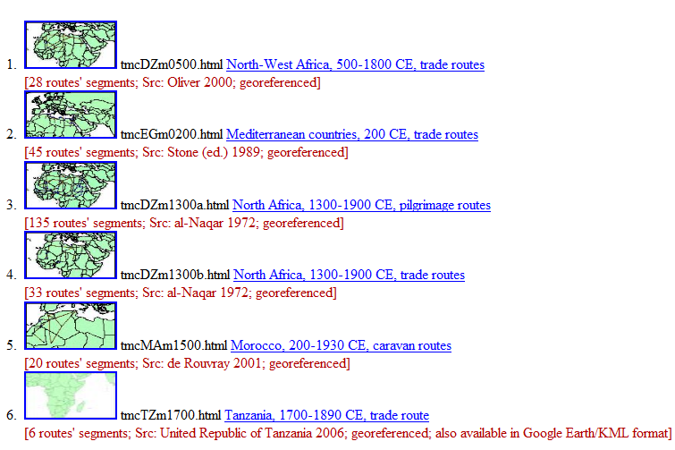
OWTRAD (Old World Trade)
http://www.ciolek.com/owtrad.html

Slide 4
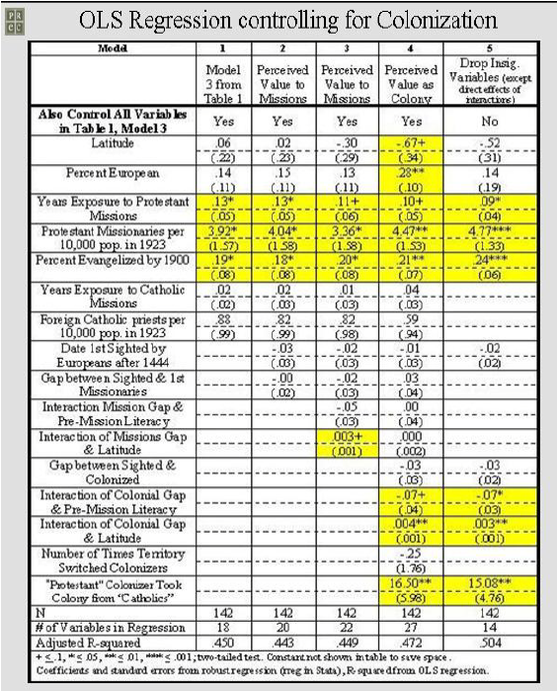
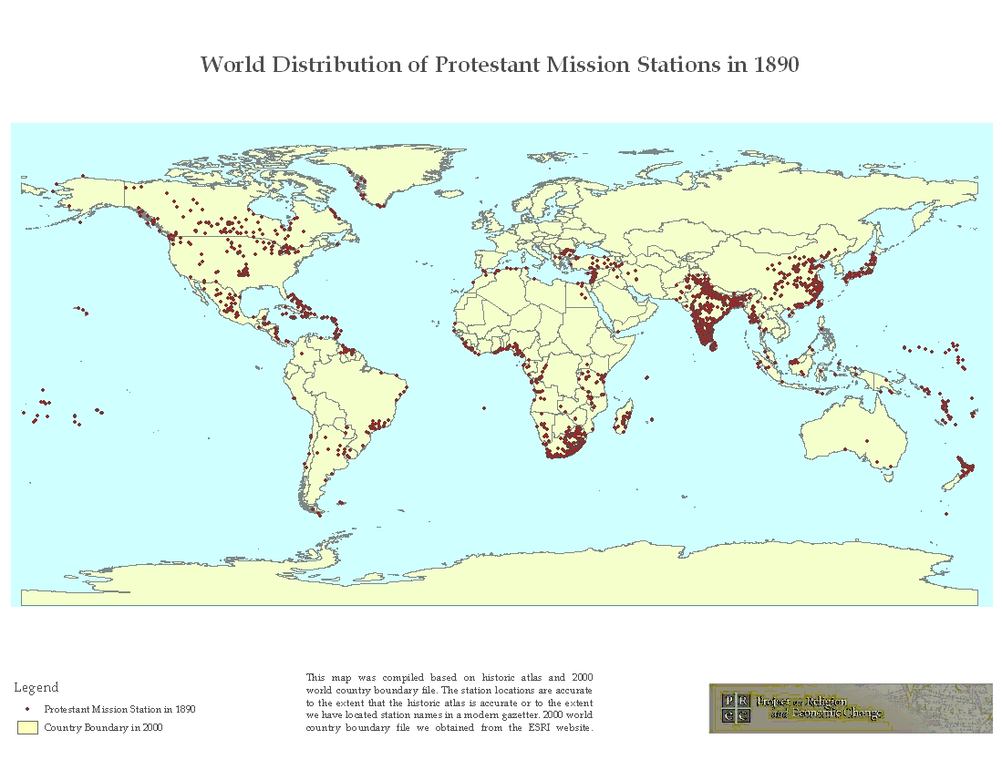
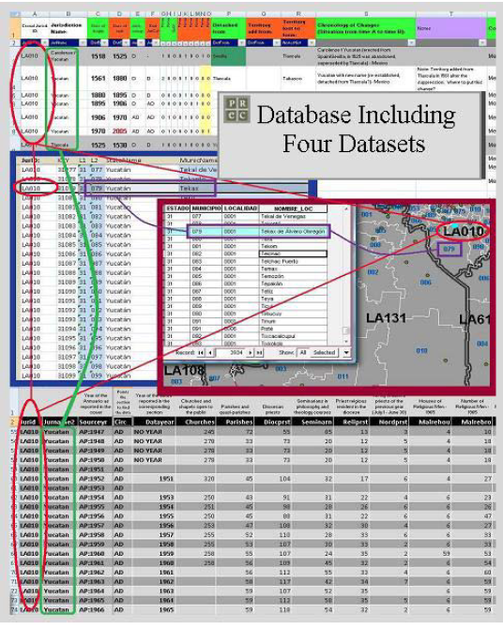
Project on Religion and Economic Change
http://www.prc.utexas.edu/prec/index.html

Slide 5
What Do These Projects Have in Common?
Data processed and collated from multiple historical sources
Curation and quality control by a single developer or small team
Downloadable data in a standardized format
Map visualization
Global scale
What Else Do We Want?
The ability to INTEGRATE spatially and temporally referenced data from MULTIPLE such projects (along with smaller, region-scale projects) for mapping, exploration, and download.

Slide 6
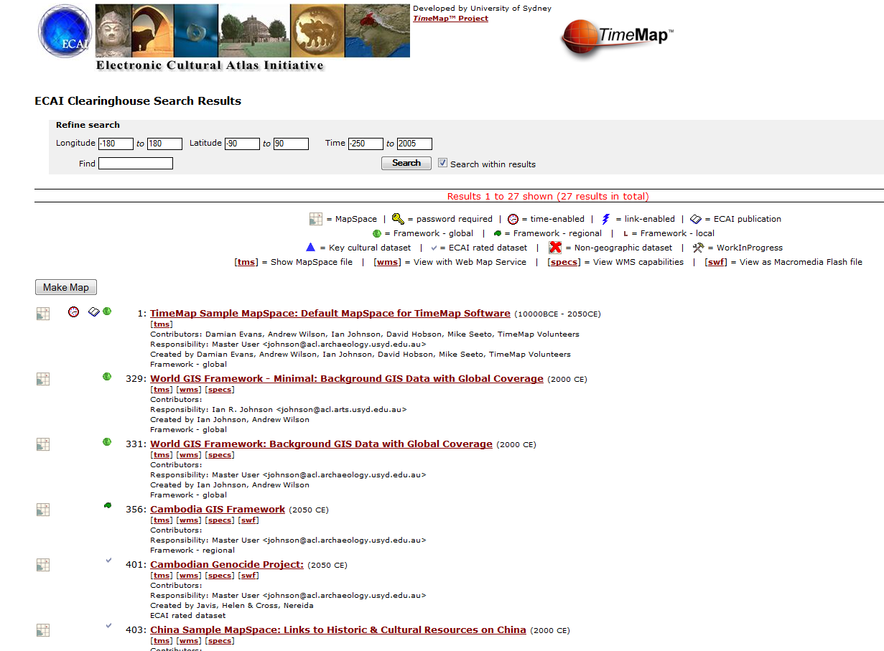
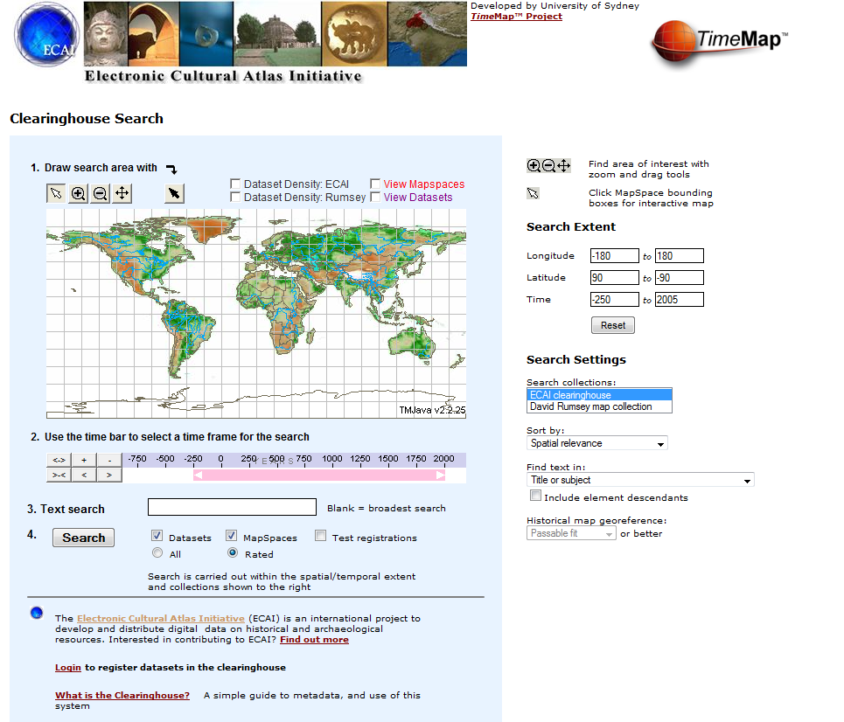
Integrative Visions 1: The Electronic Cultural Atlas Initiative (ECAI) 1999-2005
No peer review or data curation.
Cumbersome data submission and description process.
Never reached critical mass.

Slide 7
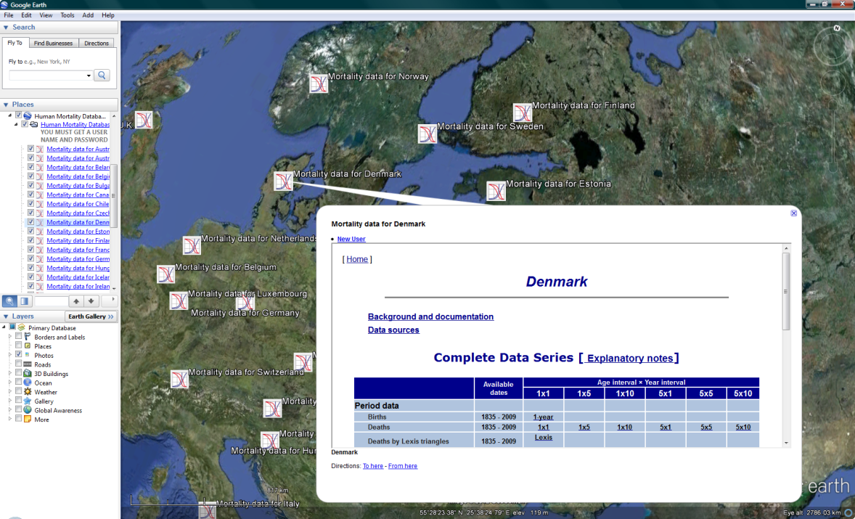
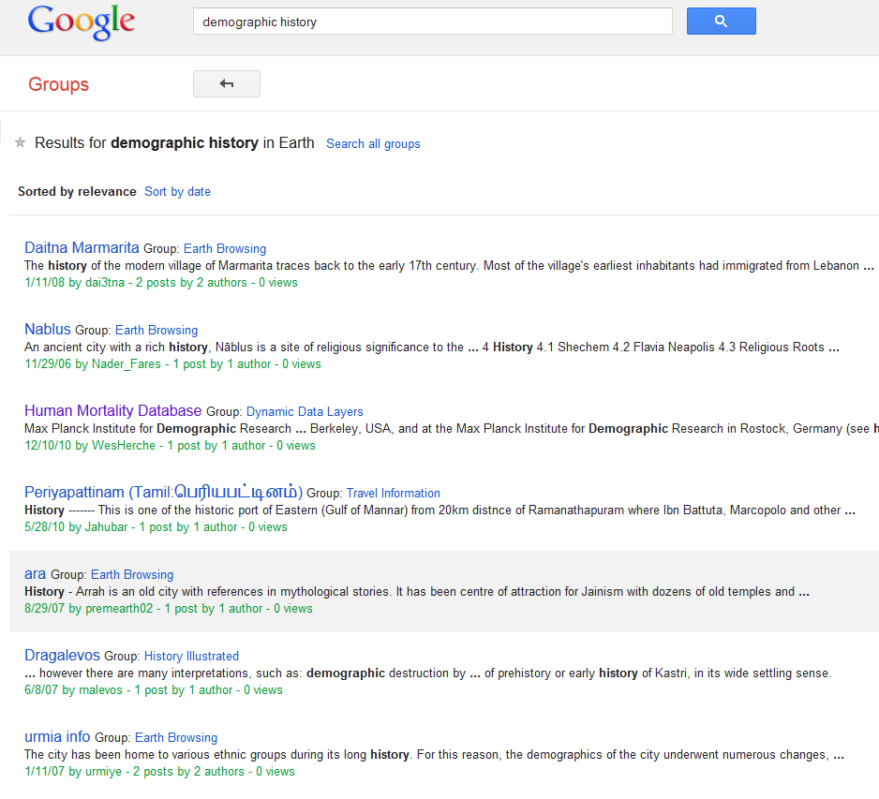
Integrative Visions 2: Google Earth Community
No editorial functions whatsoever.
No data integration tools or functions other than spatial location.

Slide 8
Challenges
Describe and structure contributed datasets to facilitate integration.
Make dataset content (e.g. historical price, territory, and census data)commensurable.
Estimate gaps and errors –rife in historical data –and interpolate data.
Peer review contributed datasets to support user confidence and credit authors.
Develop visualization tools that permit exploration and discovery using multiple datasets.
Many of these problems have never been addressed in the digital history and historical social science domain; while some have solutions only in the form of laboratory exemplars, and others have been solved only by particular authored projects

Slide 9
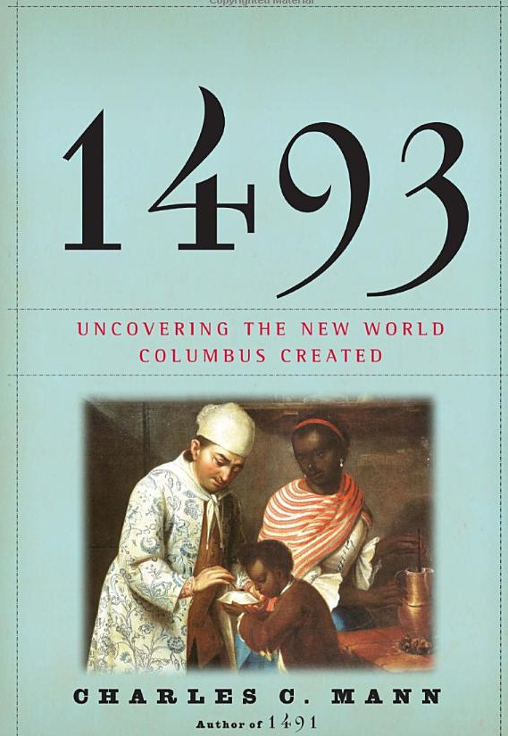
Why Bother?
The Dataverse vision promises infrastructure and content development for an empirical, integrative, history of global biological exchange, commodity circulation, new ideas, social and political changes, and demographic impacts.

